Slide 1
Flight Delay Prediction: A Machine Learning Approach
Stor 565 Group 8
Jun He
Miguel Herrera
Minli Zheng
Ruonan Zhao
Zhiyuan Yang

Slide 2
Table of contents
01
02
03
04
05
Methodology
Introduction
Model Comparison and Analysis
Conclusion
New Method Introduction and Analysis

Slide 3
01
Introduction &
Background

Slide 4
Research Motivation
Project Objectives
Research Questions
Flight delays impact passenger experience and cause significant economic losses
According to FAA, flight delays in 2023 cost approximately $29 billion, averaging $8,300 per delayed flight with 33-minute average delays
Predict flight delays and their duration using machine learning
Identify key factors affecting delays
Example: Determine delay probability for a Monday morning Atlanta-New York flight during rain
How can machine learning identify key causes of flight delays and improve prediction accuracy to support better aviation decisions?

Slide 5
02
Methodology

Slide 6
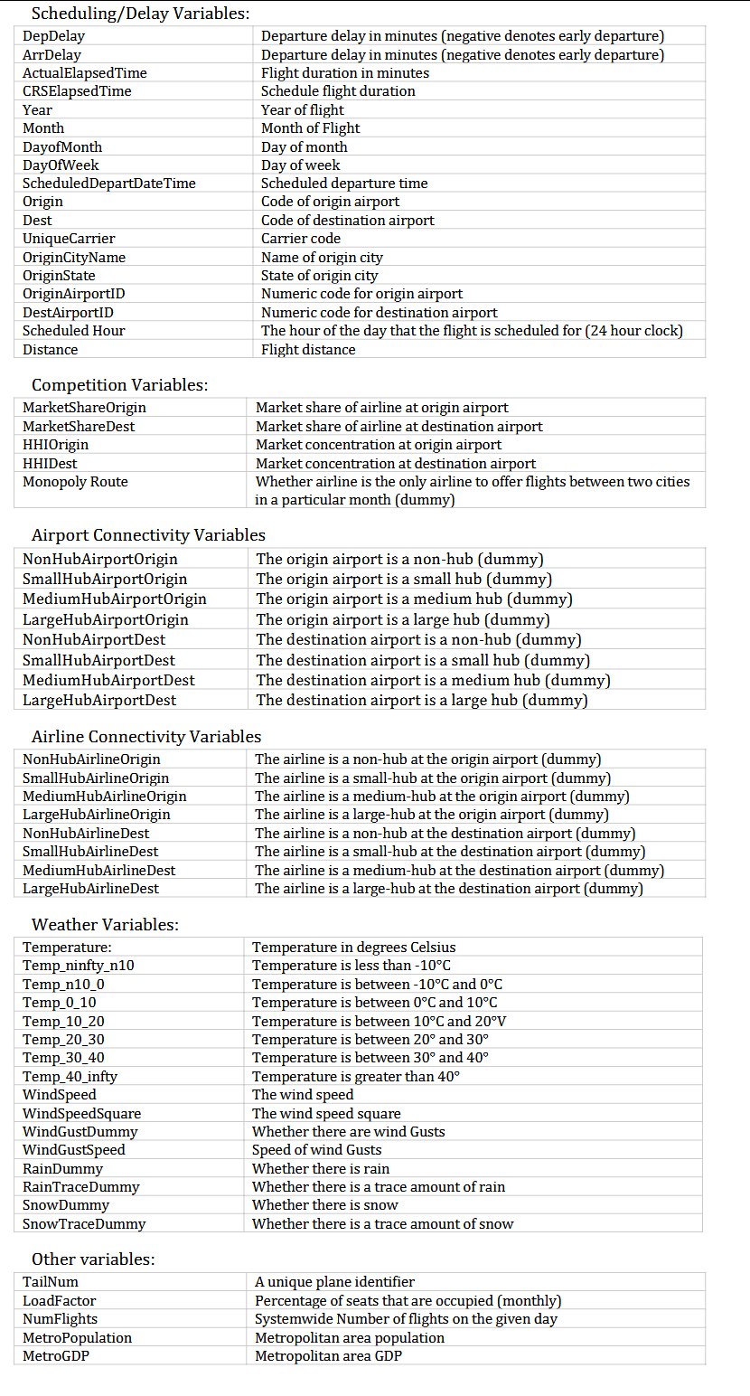
Data Description
The data set used for analysis contains data about US domestic flights from 2004 to 2017
Over 1,200,000 flight records from various airlines and airports across the country
63 columns, including departure delay, arrival delay, and 61 potential predictors related to scheduling, market competition, connectivity, weather, and more.

Slide 7
Methodology
4) Feature Selection
Used Random Forest to evaluate feature importance
Extracted and ranked most influential predictors
Retained top features that explain majority of variance
1）Data Processing
Sampled ~100,000 flights and stratified by year and airline to ensure representation
2) Feature Engineering
Categorized observations by season: January (1) → Winter
Created weekend indicator: Sunday → weekend = 1
Defined binary response: departures over 15 minutes late classified as delayed (isdelayed = 1)
5) Model Building and Evaluation
80/20 train-test split
Constructed six machine learning models for binary classification:
Basic: Logistic Regression, Naive Bayes
Intermediate: KNN, Decision Tree
Advanced: Random Forest, Gradient Boosting
Evaluated with accuracy, ROC-AUC, precision, recall, and F1 score
3) Visualization
Compare delay rates by various predictors
Plot delays vs. airlines, time and season

Slide 8
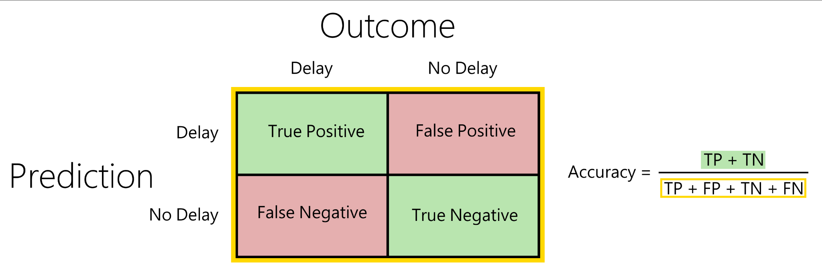
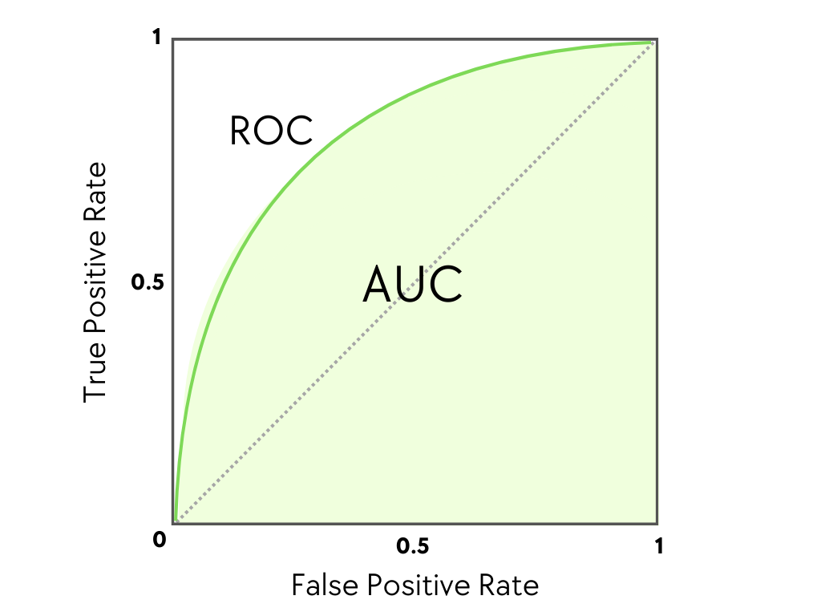
Evaluation Methods
We used two primary evaluation methods to grade the predictive strength of our binary classification models:
Accuracy: The proportion of flights’ delay status predicted correctly
AUC: Area under the ROC curve which summarizes how well the model distinguishes two classes, ranging from 0 (worst) to 1 (perfect)
We also calculated precision, recall, and F1 scores to provide a fuller picture of our models’ performance and tradeoffs.

Slide 9
03
Model Comparison and Analysis

Slide 10
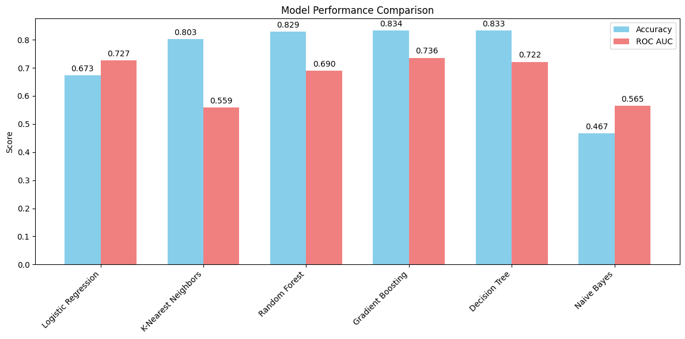
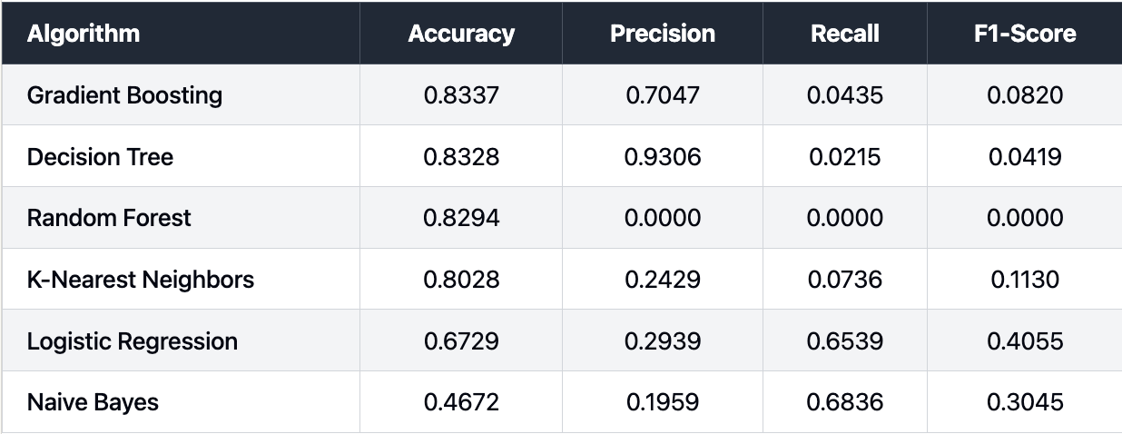
Model Comparison
Gradient Boosting outperformed all models with highest accuracy (0.834) and ROC AUC (0.736), making it the ideal choice for flight delay prediction
Tree-based models showed strong accuracy with Decision Tree (0.833) and Random Forest (0.829), while Logistic Regression demonstrated good class separation (ROC AUC: 0.727)
Most models suffered from poor sensitivity to delays, with low Recall and F1-scores. Logistic Regression and Naive Bayes, which performed worse otherwise, did better in these metrics, though.
Notes:
Random recall rate = total delayed / total sample space approximately = 19% as a baseline for both precision and recall.
Recall rate = measure how much we capture the true delay.
Precision = how many predicted delays are true delayed

Slide 11
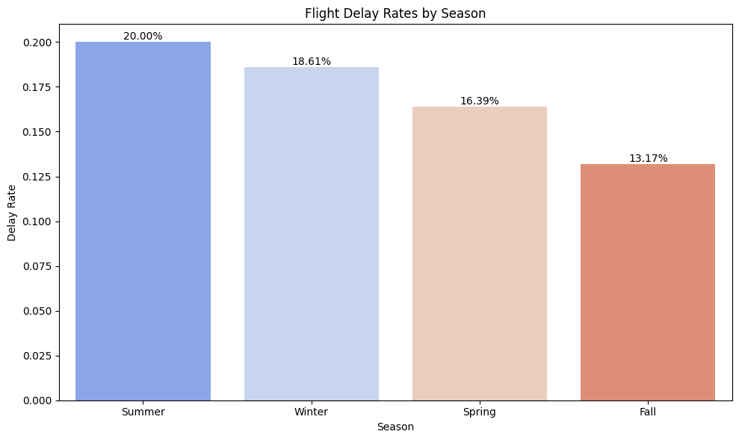
Analysis-Seasonal patterns
Summer has highest delay rate at 20.00%
Winter follows at 18.61%
Spring shows moderate delays at 16.39%
Fall has lowest delay rate at 13.17%
ANOVA test confirms significant difference

Slide 12
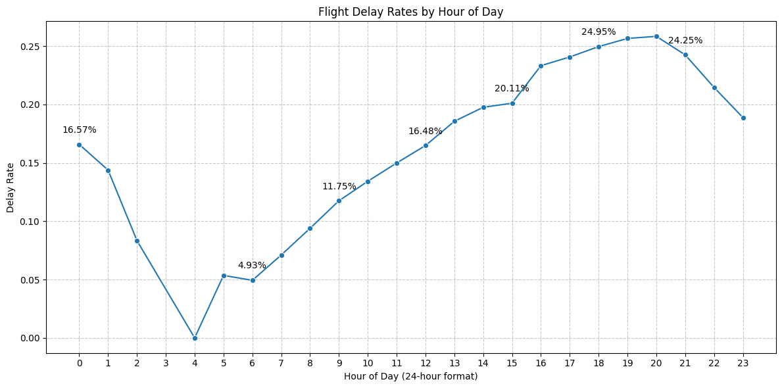
Analysis-Time of day
Early morning flights (4-6AM) have lowest delay rates (<5%) and Evening flights (6-8PM) have the highest
20:00 (6PM): 24.95% delay rate
6AM: 4.93% delay rate (n=6386)
Only 3 flights at 4am
ANOVA test confirms significant difference

Slide 13
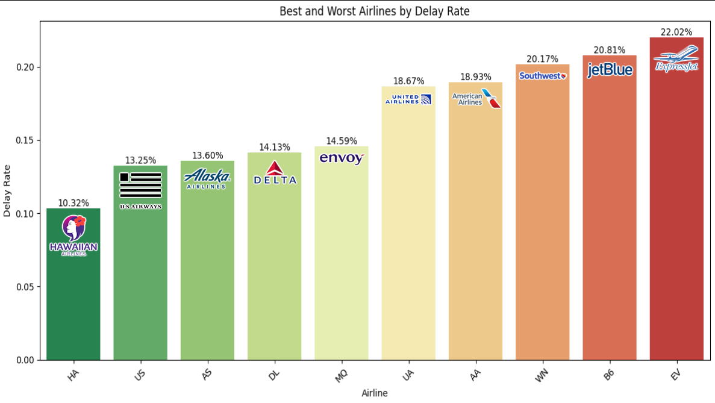
Analysis-Airline carriers Performance
Best performers:
Hawaiian (10.32%)
US Airways (13.25%)
Alaska (13.60%)
Worst performers: ExpressJet (22.02%) JetBlue (20.81%)
Southwest (20.17%)
ANOVA test confirms significant difference

Slide 14


Slide 15
04
New Method Introduction and Analysis

Slide 16
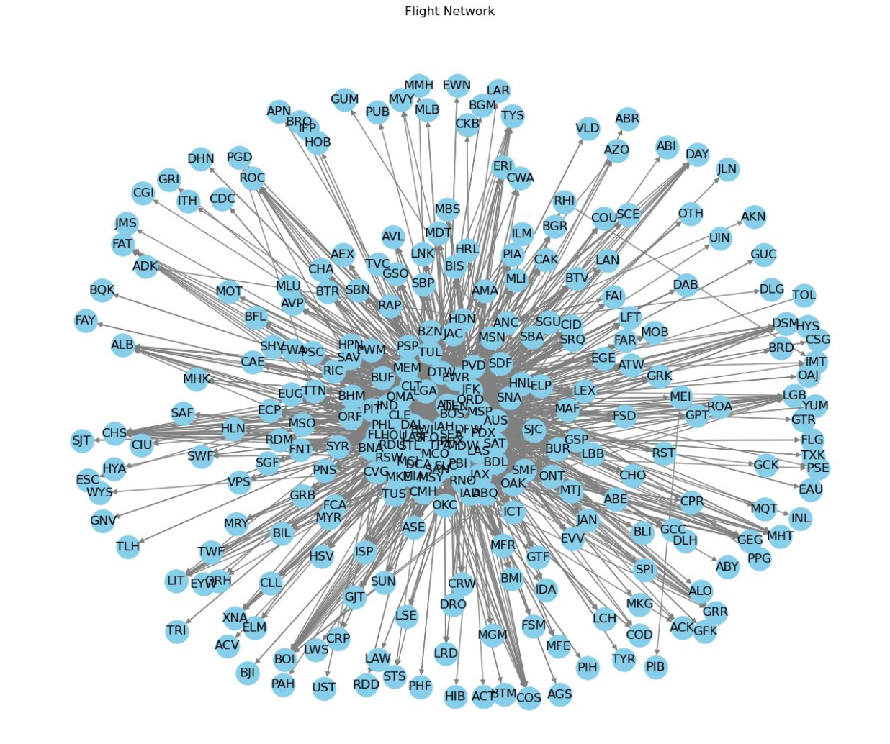
Introducing A New Method:
Intuition:

Slide 17
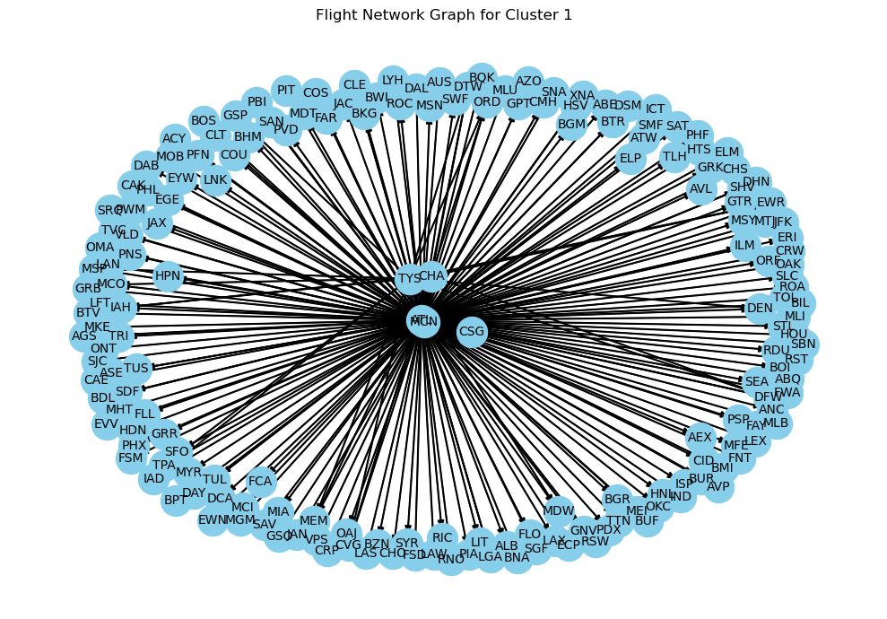

Slide 18
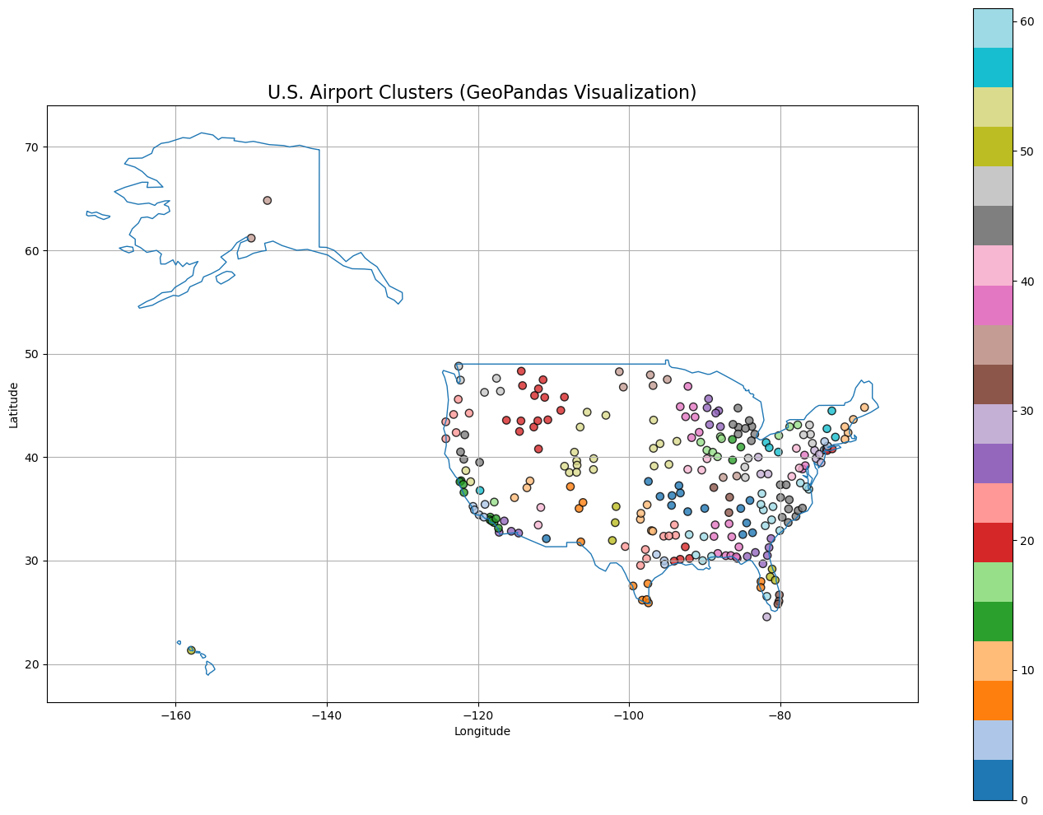
Notes:
Longitude, Latitude downloaded from Openflight.

Slide 19
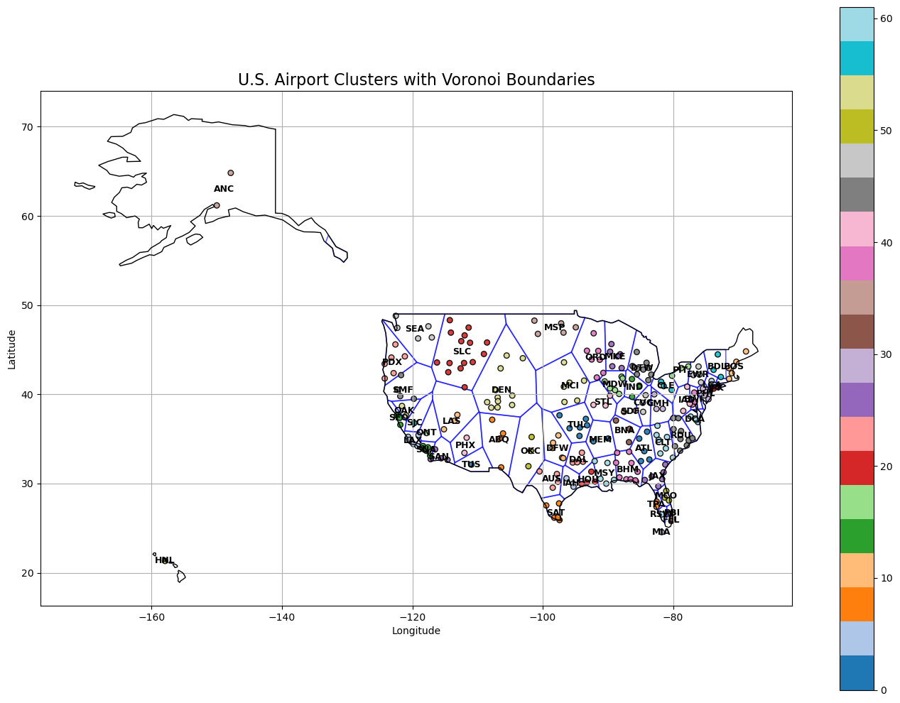

Slide 20
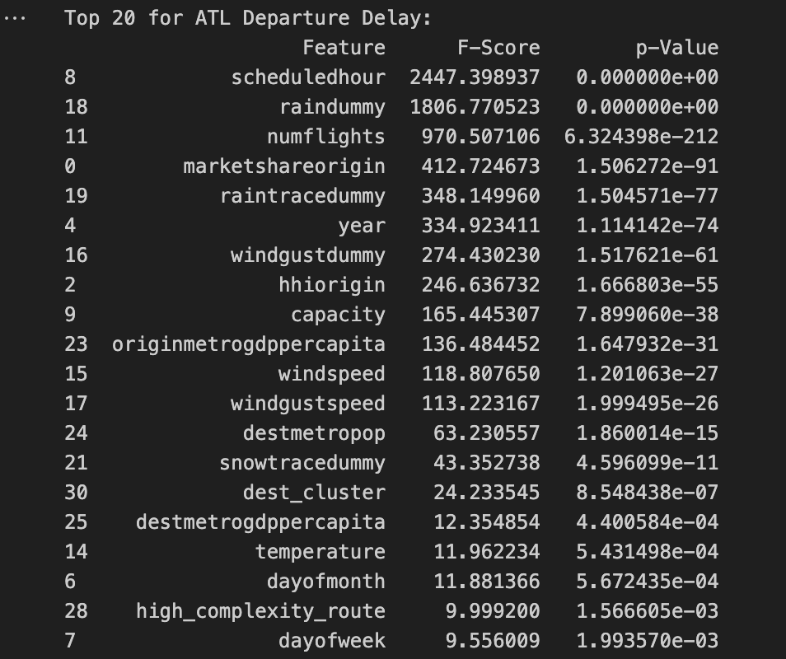
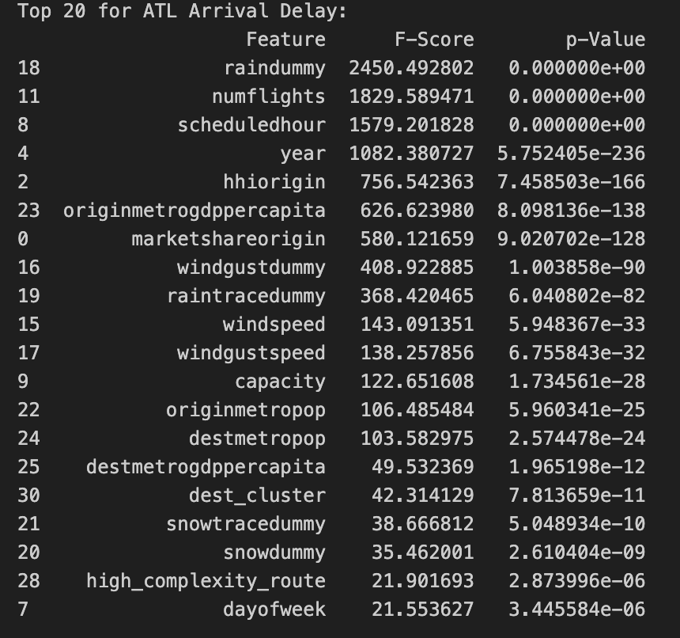

Slide 21
Our Model:
Split the whole “cleaned” version data into 80% training and 20% testing.
Steps:
Train the departure delays first:
For each row, find its corresponding departure cluster.
We set the threshold within 10 minutes as a Departure Delay Flag.
Use Extreme Gradient Boosting algorithm, refer as XGBoost, to train the local cluster departure delay model.
All 62 clusters will be trained based on the training set.
Train the arrival delays afterward:
Reason: Arrival delays are usually highly correlated to departure delays.
Training the arrival delays model for each cluster follows the same logic as departure delay but adding departure delays as a feature.
Testing:
The model will automatically recognized which cluster each row belongs to
Activate the departure delay prediction first, and pass the result as the feature to arrival delay prediction model afterward

Slide 22
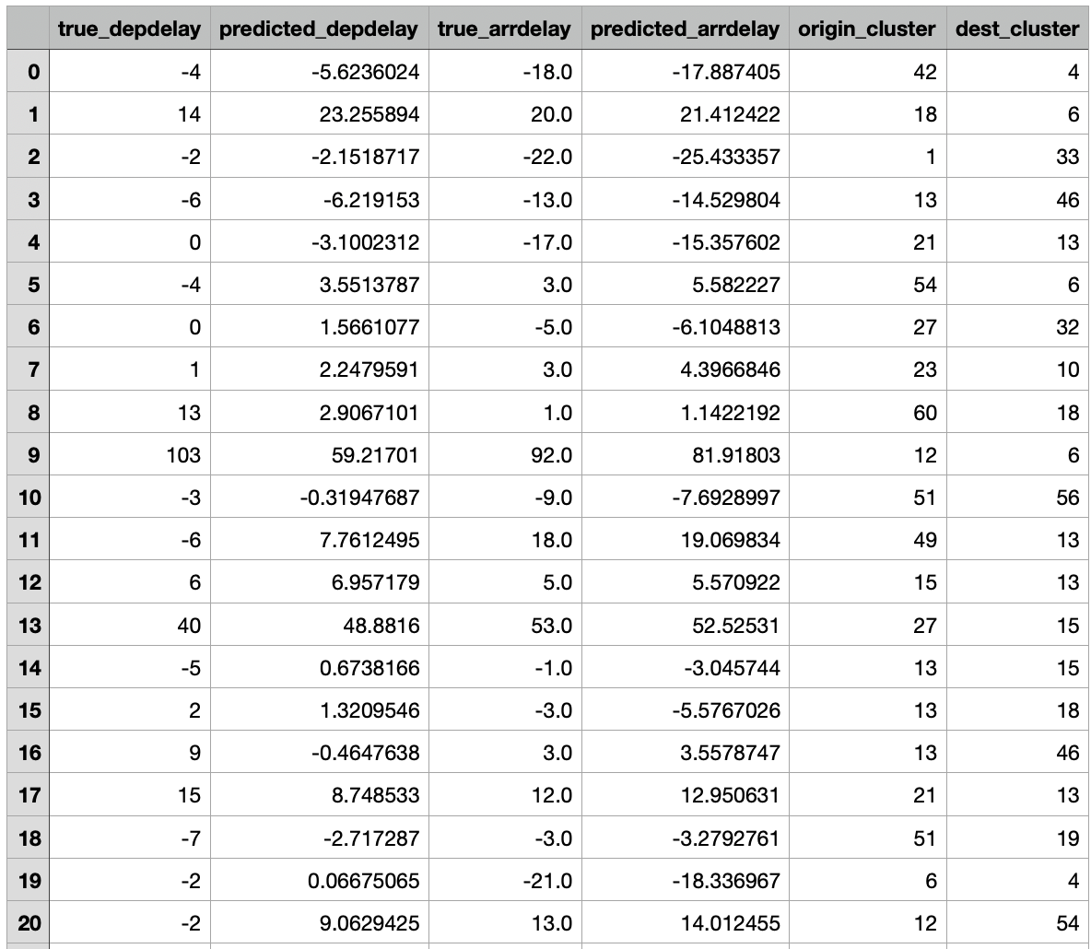
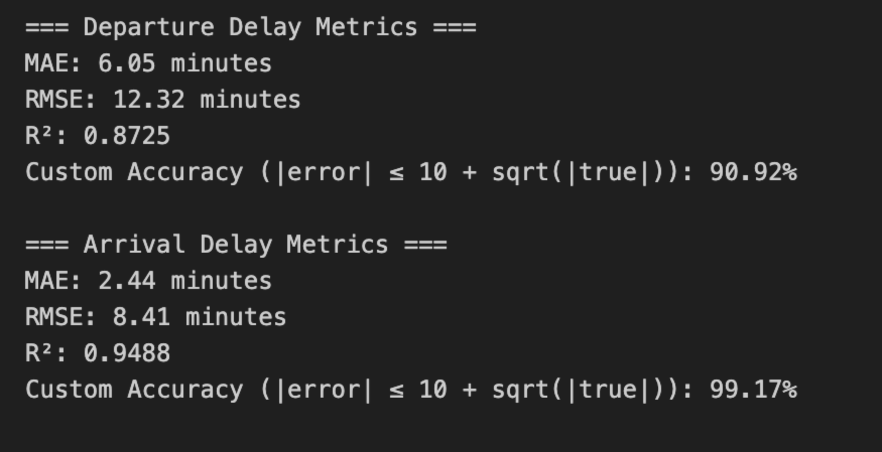
Results:

Slide 23
Pros and Cons:
Pros:
Reduced network complexity
From 259 airports to 62 clusters
Fast computation
5 minutes and a half to process all model over 1 million rows
High precision for time delay detection
Solve the problem for small airports not having enough information train its model
Flexibility
Easy to predict new flight, even if it’s airport is not listed
Cons:
Model performance can be inconsistent
Some clusters have strong data others might be weak
With dozens of separate models, it’s difficult to understand why a flight is delayed

Slide 24
05
Conclusion

Slide 25
Gradient Boosting model performs best - 83.37% accuracy, 70.47% precision, ideal for flight delay prediction
Key influencing factors - Scheduled departure time (22.5%), historical route delay rate (17.2%), and weather conditions are critical predictors
Travel recommendations - Choose early morning flights (4-6 AM), avoid evening rush (6-8 PM), prefer lower delay airlines like Alaska, Delta, and Hawaiian
Future improvements - Incorporate additional meteorological data, develop real-time prediction systems, enhance model performance in extreme conditions

Slide 26
Work Cited:
https://openflights.org/data.php#airport
https://www.worldscientific.com/doi/abs/10.1142/S0218001421590278
https://link.springer.com/article/10.1007/s42405-024-00855-w
https://dl.acm.org/doi/fullHtml/10.1145/3497701.3497725
https://ieeexplore.ieee.org/abstract/document/7778092
https://ieeexplore.ieee.org/abstract/document/8903554

Slide 27
Thanks!
Any questions?

